Slide 1
coffee sales 45
File created on: 21-03-2023 22:23:12

Slide 2
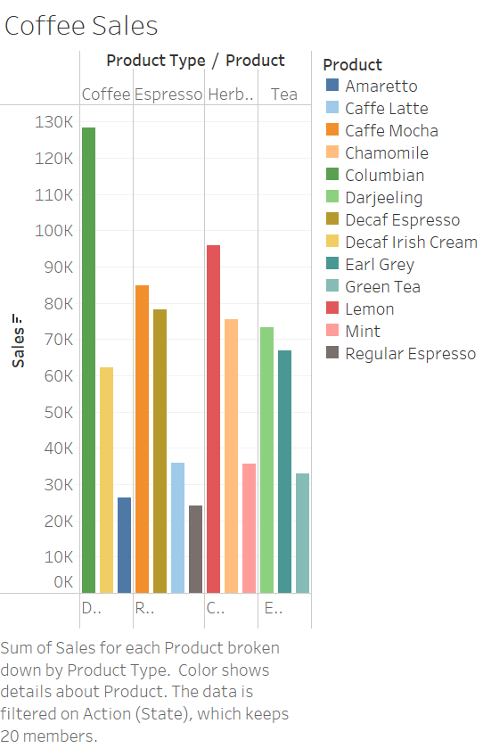

Slide 3
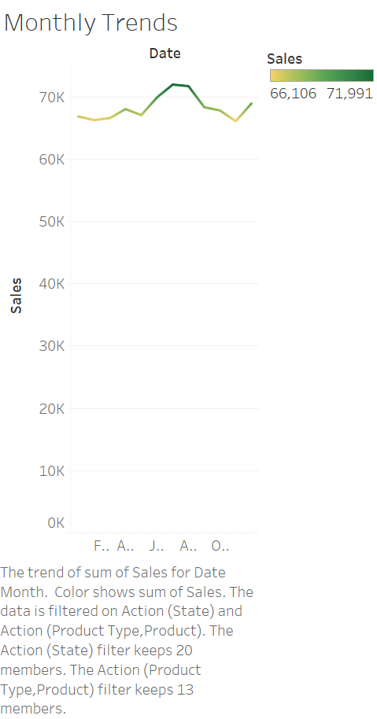

Slide 4
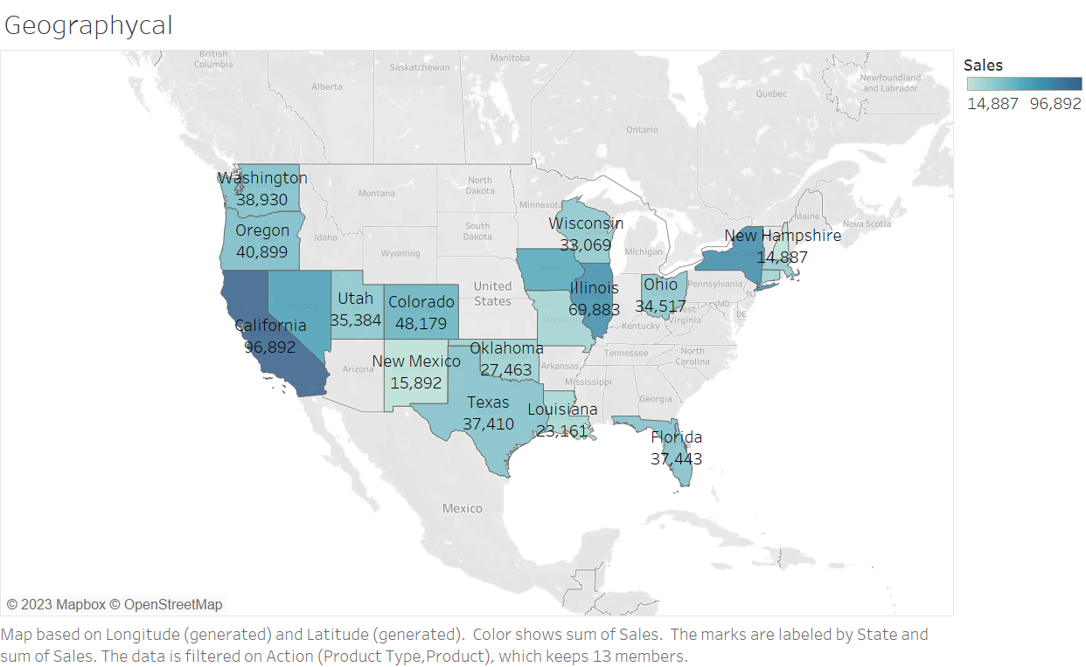

Slide 5
